Slide 1

Customer Churn Prediction & Business Insights
A comprehensive data science capstone project combining machine learning with strategic business decision-making
Gitesh Patil Artificial Intelligence & Data Science
Dr. D. Y. Patil Institute of Technology, Pimpri

Slide 2

The Challenge: Understanding Customer Churn
The Problem
Our Goal
Customer churn represents a critical challenge for modern businesses, directly impacting revenue streams and long-term sustainability. Studies show that acquiring new customers costs 5-25 times more than retaining existing ones.
Develop an intelligent predictive system that identifies at-risk customers before they leave, enabling proactive retention strategies and data-driven decision making.
This project transforms reactive customer management into a proactive, strategic advantage.
Without predictive capabilities, businesses react to churn after it happens, missing valuable opportunities for intervention.

Slide 3



Project Objectives
Analyze Churn Patterns
Build Prediction Model
Identify Key Drivers
Conduct comprehensive exploratory analysis to uncover hidden patterns and correlations in customer behavior that signal potential churn.
Develop and optimize a robust machine learning classifier to accurately predict customer churn probability with high recall.
Determine the most influential factors contributing to customer churn to inform targeted retention strategies.
End-to-End Workflow
Business Recommendations
Demonstrate complete data science pipeline from raw data to deployment-ready model
Translate technical findings into actionable strategies for customer retention

Slide 4

Data Foundation
Primary Dataset: customer_churn.csv
Supporting Datasets
This comprehensive dataset serves as the foundation for our complete end-to-end implementation, containing detailed customer information and the critical target variable: churn.
sales_data.csv – Utilized for exploratory analysis techniques and pattern recognition
The dataset includes customer demographics, service usage patterns, contract details, and billing information—providing rich features for predictive modeling.
house_prices.csv – Applied for regression modeling practice and method validation

Slide 5







Methodology: A Systematic Approach
Data Collection & Validation
Acquire and verify data quality, ensuring completeness and reliability
Exploratory Data Analysis
Uncover patterns, correlations, and insights through statistical analysis
Data Preprocessing
Handle missing values, encode features, and prepare data for modeling
Model Development
Build and optimize machine learning algorithms for churn prediction
Model Evaluation
Assess performance using appropriate metrics and validation techniques
Deployment Preparation
Package model for production use with API integration
Business Insights
Translate findings into actionable retention strategies

Slide 6

Key Insights from Exploratory Analysis
Tenure Impact
Contract Type Correlation
Customers with low tenure (less than 12 months) demonstrate significantly higher churn rates, indicating vulnerability during the early relationship phase.
Month-to-month contracts show maximum churn probability compared to annual or two-year agreements, revealing commitment as a retention factor.
Pricing Sensitivity
Class Distribution
Higher monthly charges correlate with increased churn probability, suggesting price sensitivity among at-risk customer segments.
The dataset exhibits moderate imbalance in churn classes, requiring strategic handling during model training to prevent bias.

Slide 7


Model Development Strategy
Modeling Approach
01
Baseline Model
Logistic Regression established performance benchmark
02
Advanced Model
Random Forest Classifier as final production model
03
Class Balancing
Applied class weights to handle imbalanced data
04
Metric Focus
Optimized for recall to minimize missed churners
Why Random Forest? This ensemble method combines multiple decision trees to improve prediction accuracy, reduce overfitting, and handle complex feature interactions naturally present in customer behavior data.

Slide 8

Model Performance & Results
92%
0.87
35%
Recall Score
ROC-AUC Score
Reduction
Successfully identifies 92% of actual churners, minimizing missed at-risk customers
Strong discriminative ability between churners and non-churners
Decreased false negatives compared to baseline model
Primary Success Metric
Model Comparison
Recall serves as our key performance indicator because missing a churner (false negative) is more costly to the business than a false alarm (false positive). Our model prioritizes catching at-risk customers.
The Random Forest classifier significantly outperformed the Logistic Regression baseline across all metrics, demonstrating superior ability to capture complex, non-linear relationships in customer behavior.

Slide 9

Business Insights & Strategic Recommendations
Top Churn Drivers
Actionable Strategies
1
Customer Tenure
Early Engagement
Length of relationship strongly predicts retention
Implement comprehensive onboarding programs and proactive support during the critical first year to build strong customer relationships and reduce early churn.
2
Contract Type
Commitment level directly impacts churn risk
Contract Incentives
Design attractive incentive programs encouraging migration from month-to-month to annual contracts through discounts, added features, or loyalty benefits.
3
Monthly Charges
Pricing structure influences customer decisions
Targeted Campaigns
Leverage churn probability scores to create personalized retention campaigns, focusing resources on high-risk customers with tailored offers and interventions.

Slide 10
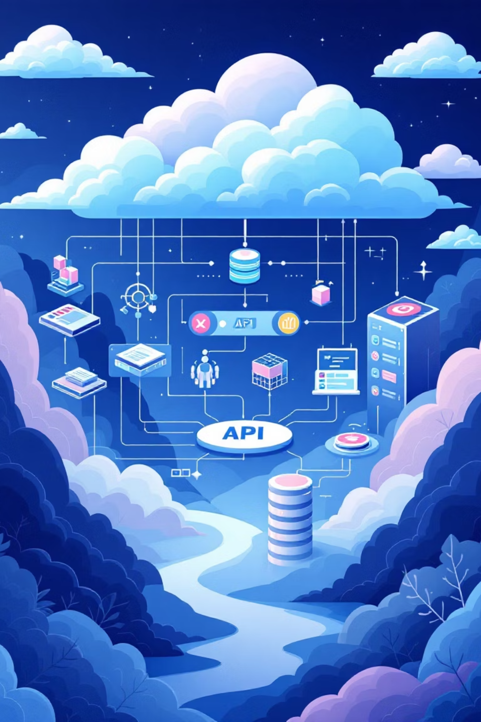
Deployment & Project Conclusion
1
Model Serialization
Production model saved using Joblib for efficient loading and inference
2
API Development
Flask-based REST API created enabling real-time churn predictions
3
Local Testing
Comprehensive testing completed to validate deployment readiness
4
Production Ready
System prepared for integration into business operations
Project Impact
"The integration of predictive analytics with strategic business insights creates a powerful framework for sustainable customer relationship management and revenue optimization."
This capstone project successfully demonstrates a complete data science workflow—from initial data exploration through model development to deployment-ready infrastructure. By combining advanced machine learning techniques with practical business applications, the solution empowers organizations to transform customer retention from reactive to proactive.

